Slide 1




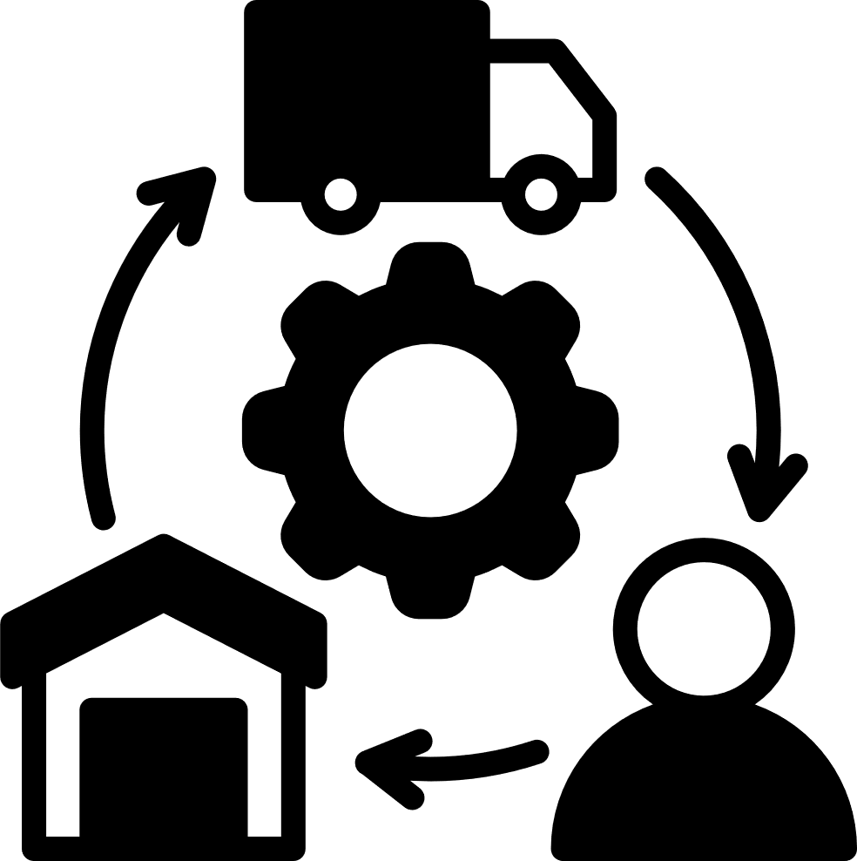

Project 2
OPERATIONAL RESILIENCE AUDIT
Multi-variable Risk Modeling & Logistics Efficiency Optimization
Presented By : Paul Kamande
Notes:
Welcome to the insightful realm of our logistics resilience audit results. We have identified four fundamental pillars to enhance our operations: addressing estimated time of arrival (ETA) discrepancies during periods of stress, assessing the readiness of our buffer stock, establishing predictive risk management strategies, and identifying areas where GPS inefficiencies are impacting costs and resources.
Our approach incorporates several innovative techniques: unit-corrected analytics, time-sensitive breakdowns for transparency, a linear model for effective interactions, and hotspot clustering to identify key areas of focus. Each recommendation is supported by valuable metrics—such as plots, thresholds, or rankings—designed to empower planners and supervisors to take informed action.
Our goal is to foster understanding rather than merely showcasing complex models. For those interested in further details, the accompanying report serves as a comprehensive resource, detailing assumptions, diagnostics, and the complete overview of our findings. Enjoy the journey!

Slide 2



PROJECT OBJECTIVES
Identify ETA-variation drivers under weather/traffic stress
Test buffer-stock adequacy vs. failure rate by quartile
Calibrate predictive risk bands and guardrails
Locate GPS drainage hotspots with DBSCAN
Deliver thresholds, playbooks, and KPIs
Notes:
Our objectives were to quantify the factors influencing ETA variation, assess the adequacy of current inventory buffers, establish predictive parameters for operational guidance, and identify GPS hotspots where assets and fuel are disproportionately depleted. We employed interpretable methods and stress surfaces to translate patterns into actionable, threshold-based initiatives. The results include lane-level playbooks, reliability thresholds aligned with the 95th percentile of ETA variation, and rankings of hotspots to prioritize routing and refueling efforts. Key Performance Indicators (KPIs) such as P95 ETA variation and drainage scores will be utilized to monitor improvements and facilitate ongoing adjustments.

Slide 3

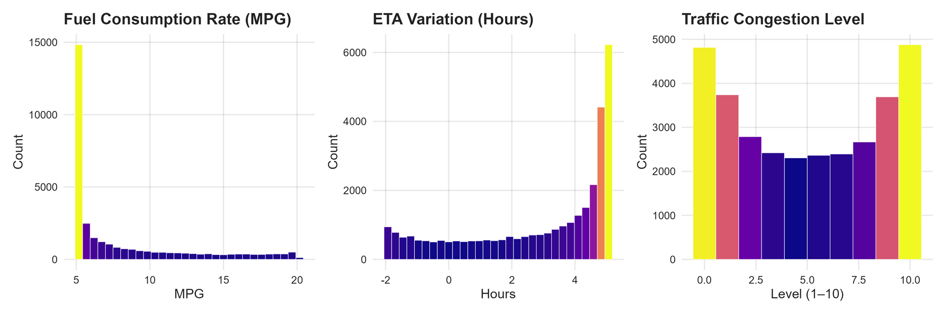
DATA AND METHODOLOGY
Telemetry, traffic, weather, inventory, cost
Unit fixes; planned lead time; efficiency ratios
Time-aware 80/20 split to prevent leakage
Linear interaction model (traffic×weather)
Yardstick metrics; reliability surface
Notes:
We integrated various data sources, including telemetry, traffic, weather, costs, and inventory. Units were standardized, and we calculated the planned lead time by adjusting the estimated time of arrival (ETA) variation, converting hours to days. Efficiency ratios, such as fuel-to-cost and fuel-to-lead-time, facilitated the ranking and scoring of hotspots. To mitigate data leakage, we employed an 80/20 chronological split. A linear model incorporating a traffic-weather interaction effectively captures the multiplicative stress effects, creating an interpretable framework for guardrails. Furthermore, yardstick metrics were utilized to assess out-of-sample performance. The resultant output is a reliability surface that correlates operating conditions with predicted ETA risk.

Slide 4

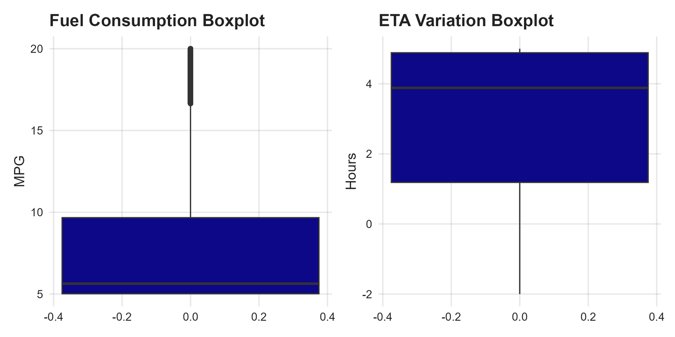

DISTRIBUTION & OUTLIERS
Right-skew in MPG and ETA variation
High-end outliers present in both
Tails inflate risk beyond averages
Motivates percentile guardrails
Supports robust/quantile modeling
Procurement Management – Involves selecting reliable suppliers, negotiating contracts, and ensuring the timely acquisition of quality materials.
Notes:
The histograms and boxplots indicate skewness and long tails in fuel consumption and estimated time of arrival (ETA) variation. Outliers, evident as whisker-bound extremes, can significantly influence service risk. Relying on averages obscures these effects; therefore, planning should incorporate percentile-based thresholds for buffers and escalation measures. These distributions elucidate the presence of heavy tails in the residuals, suggesting that a robust or quantile-based modeling approach may be more effective in aligning with operational decision-making. This is particularly crucial as such decisions prioritize worst-case reliability over mean error.

Slide 5
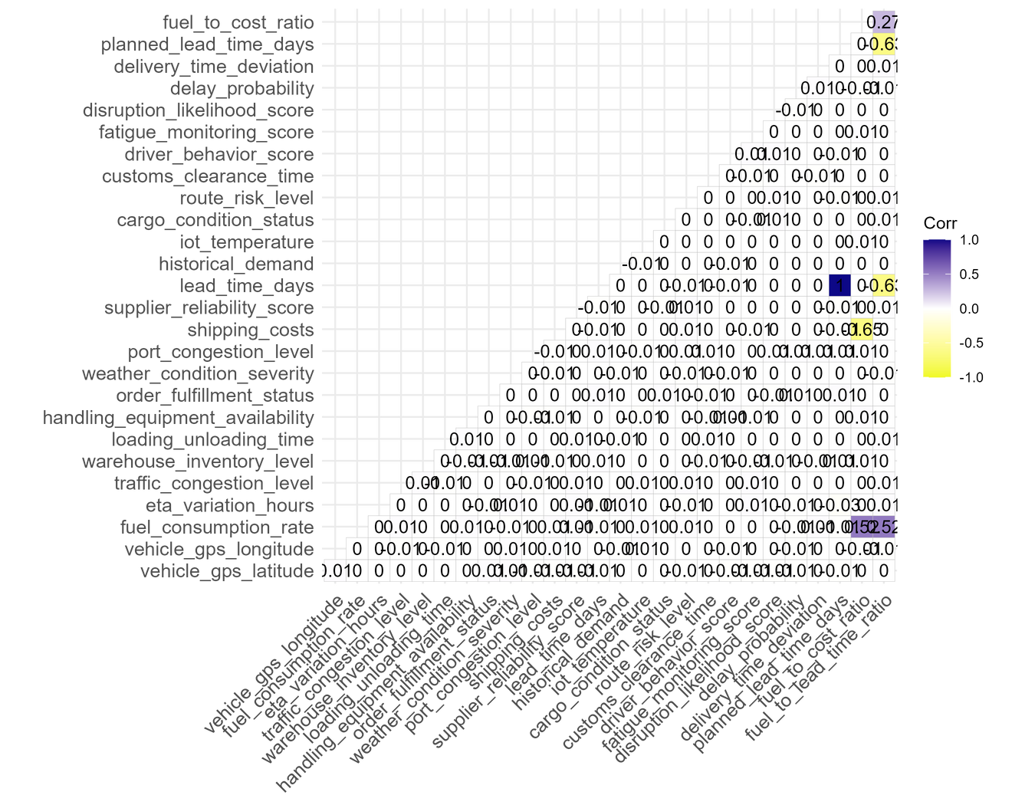
CORRELATION HIGHLIGHTS
Data Analytics
Annotated lower-triangle with labels
Lead time relates to shipping costs
Modest pairwise links otherwise
Interactions favored over many terms
Parsimony reduces overfitting risk
Notes:
The correlation matrix showcases modest-to-moderate relationships. Lead time and shipping costs co-move, as expected. The generally low pairwise correlations argue for parsimonious feature sets and carefully chosen interactions rather than large, black-box models. This supports the decision to model traffic and weather multiplicatively and keep other terms interpretable. The outcome is a surface and thresholds that ops can use in planning without opaque logic.

Slide 6

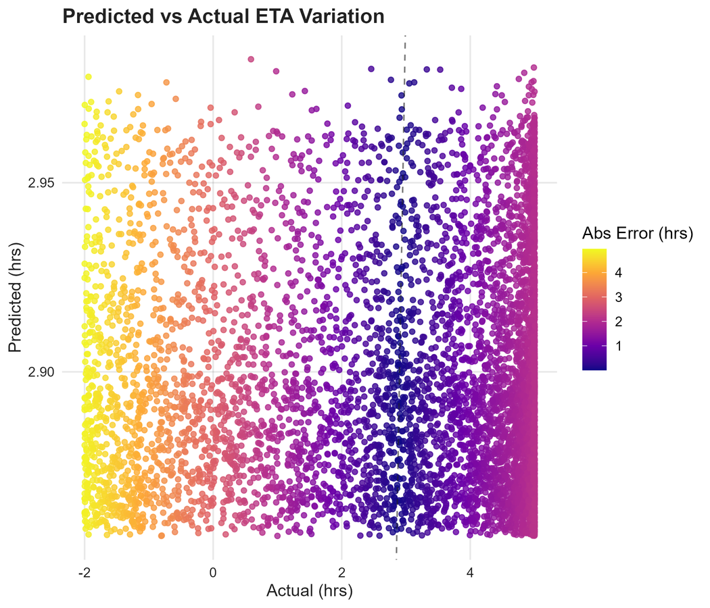
MODEL FIT & ERROR
Central calibration acceptable
Errors increase at extremes
Identity line aids visual QA
Use model for guardrails now
Upgrade to GBM for SLA later
Adopt Automation & Technology
Notes:
Predicted versus actual ETA variation shows that the model captures central tendencies but underperforms at extremes, which is typical when shocks are unobserved. For immediate operationalization, we recommend using this model to set guardrails rather than promises of SLA-level accuracy. For production forecasting, move toward robust regression or gradient boosting with temporal/incident features. The identity line helps quickly spot bias and drift over time.

Slide 7
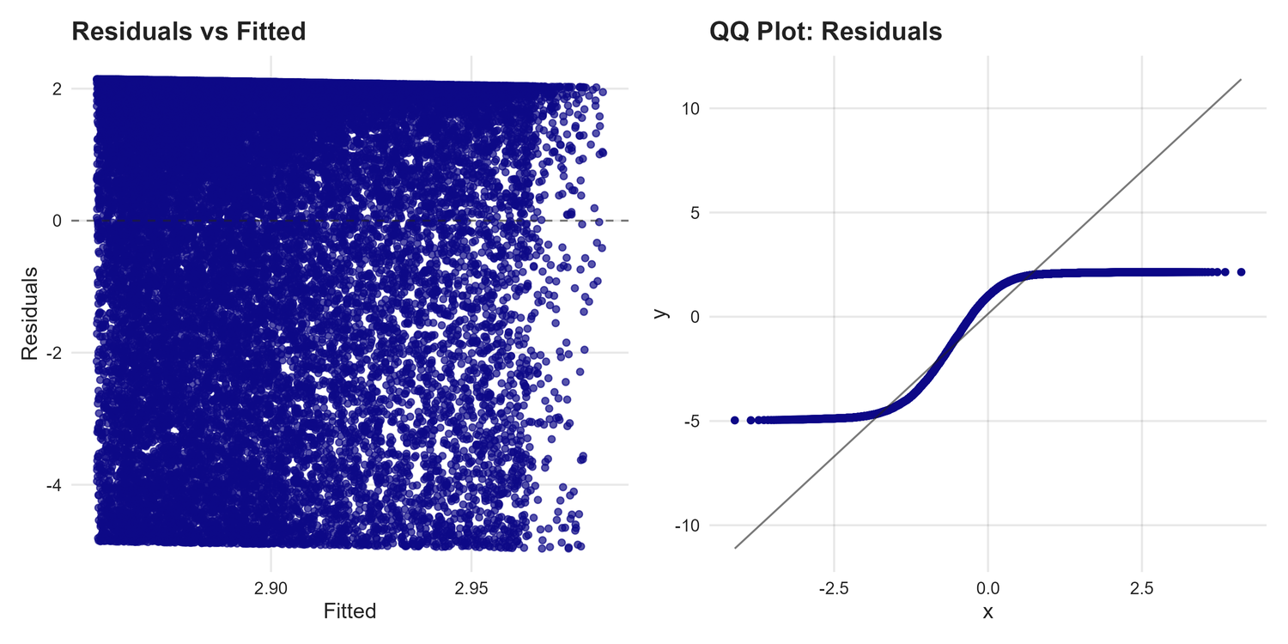
DIAGNOSTICS
Residuals vs. fitted: mild heteroskedasticity
QQ plot: heavy tails vs. normality
Confirms need for quantile thresholds
Motivates robust/variance-aware models
Monitor drift and re-fit quarterly
Notes:
Diagnostics indicate variance increases with predicted values and the residual distribution departs from normality. This supports our recommendation to use percentile thresholds operationally and to trial robust or variance-aware models in the next iteration. Regular drift checks and quarterly re-fits will keep the model aligned with changing conditions, especially as routes, carriers, and seasonality evolve.

Slide 8
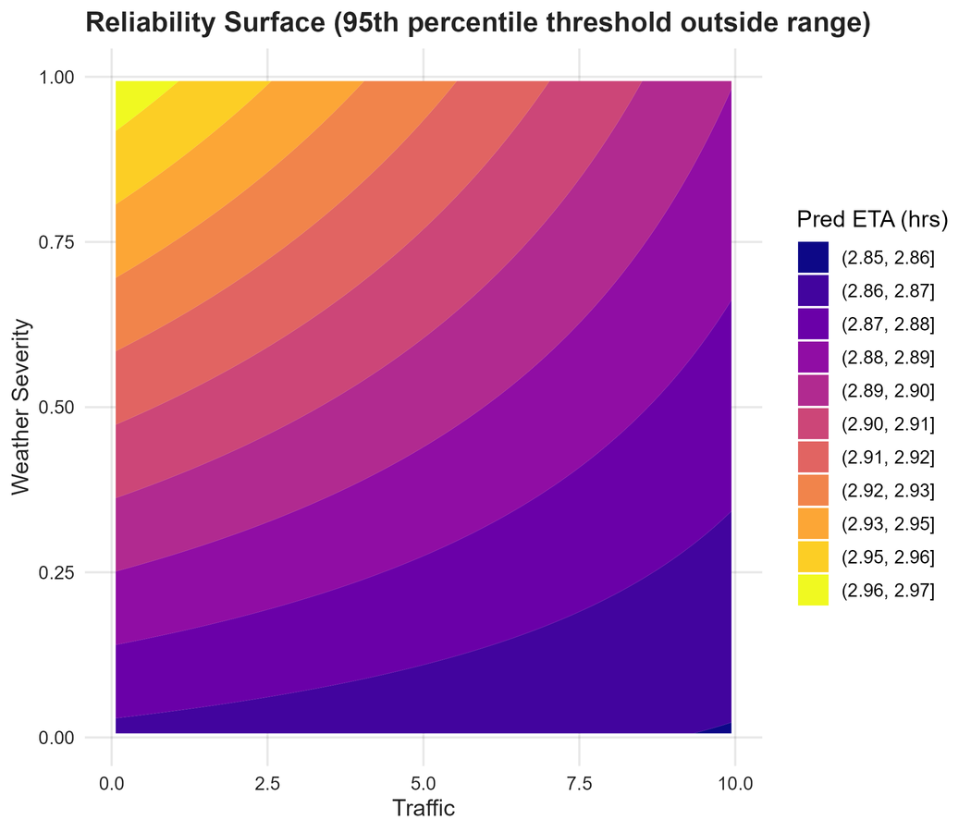
RELIABILITY SURFACE
Predicted ETA increases with traffic & weather
95th-percentile acts as guardrail
If beyond range, use filled contours
Pre-trip check: buffer or reroute
Encodes simple, auditable rules
Notes:
This surface translates intricate interactions into a straightforward planning map. When forecasting traffic and weather conditions suggest placing a lane above the guardrail, planners can either apply a buffer or select an alternate route. Even if the strict contour falls outside the modeled range, the filled contours effectively convey risk gradients that are easily quantifiable. This facilitates rapid, auditable decision-making and can be integrated into dispatch tools.

Slide 9
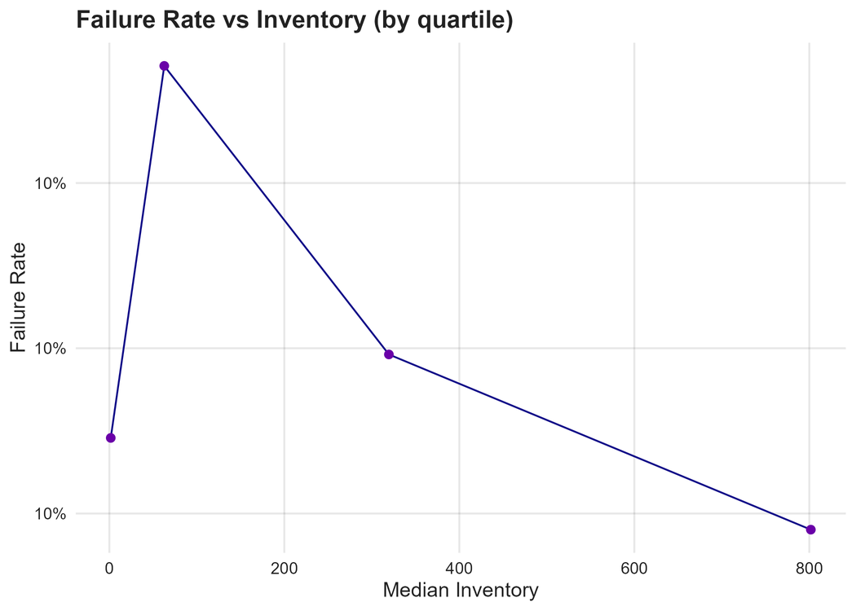
INVENTORY VS FAILURE
Failure rates fall across inventory quartiles
Target buffers to volatile lanes first
Balance holding costs with SLA risk
Review outcomes monthly
Publish lane-level playbooks
Notes:
The quartile analysis indicates that a higher median inventory significantly reduces failure rates. Instead of implementing blanket increases, it is advisable to concentrate buffers in areas with the highest ETA volatility to optimize return on investment (ROI). This strategy should be complemented by monthly reviews to monitor failure reduction and assess changes in holding costs by lane. Additionally, creating concise playbooks will guide planners on which corridors qualify for increased buffers and outline the process for reducing buffers when volatility decreases.

Slide 10
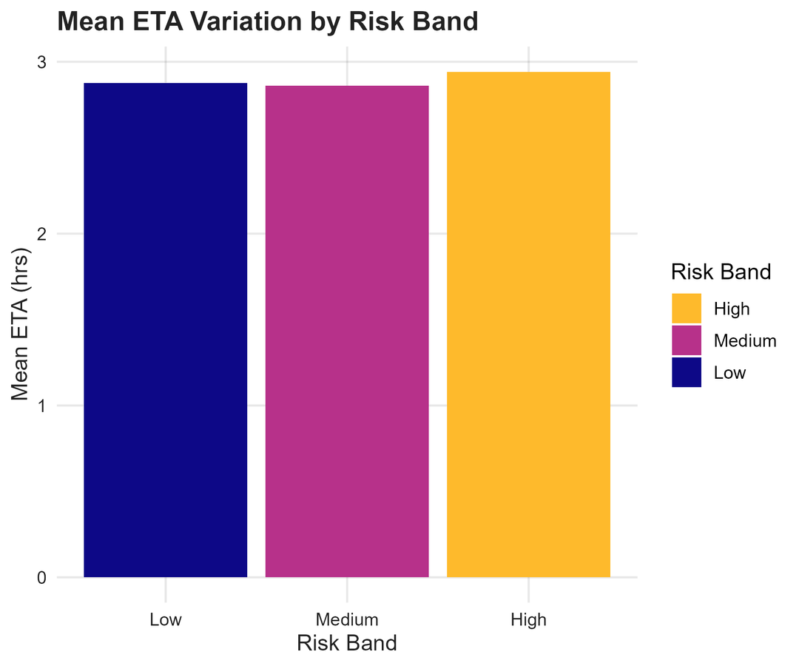
RISK BANDS & ETA
Low/Medium/High bands from likelihood score
Mean ETA rises with band level
Clear triggers for alerts/escalation
Recalibrate quarterly to data drift
Keep rules interpretable for ops
Notes:
Risk bands offer a practical framework for operational communication. As the risk band escalates, the average Estimated Time of Arrival (ETA) increases, thereby reinforcing escalation protocols such as “Medium → add buffer” and “High → escalate to supervisor or reroute.” It is advisable to recalibrate these bands quarterly to account for shifts in distributions. Transparent risk bands facilitate clear policy explanations for frontline teams and ensure compliance with audit requirements.

Slide 11
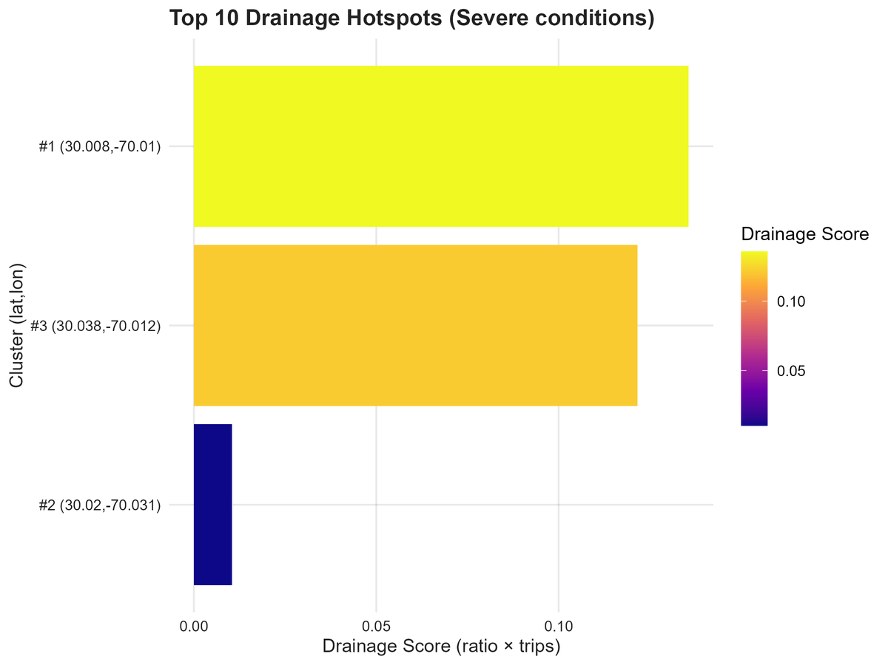
DRAINAGE HOTSPOTS
DBSCAN under severe conditions
Drainage score = fuel-to-cost × trips
Few clusters dominate losses
Route/Refuel policy fixes first
Conduct on-site ops reviews
Notes:
Hotspot clustering identifies a limited number of GPS clusters responsible for a significant portion of fuel and cost inefficiencies. These clusters represent ideal targets for immediate intervention. Recommended actions include testing alternative routing options, enforcing a refueling strategy—such as avoiding premium fuel stations—and reviewing local practices that may prolong dwell times or necessitate detours. Monitoring drainage scores on a month-over-month basis will allow us to assess the effectiveness of these interventions and determine future areas of focus.

Slide 12
REFERENCES
PROJECT 2
Internal operational memo & data dictionary
Model artifacts and metrics (pipeline outputs)
Figures generated from supplied dataset
Guardrail thresholds from P95 ETA
Versioned monthly KPI reports
Notes:
References include the internal memo, the data dictionary, and the artifacts created by this pipeline. All plots were generated from the supplied dataset after cleaning and feature engineering. Guardrail thresholds rely on the 95th percentile of ETA variation from the training period. We recommend maintaining versioned monthly KPI reports so changes in performance, thresholds, and hotspots are auditable and reproducible.

Slide 13
PROJECT 2
THANK YOU

